Slide 1
Behavior of Gases

Slide 2
What is a Gas??
A gas is a state of matter that has NO definite volume and NO definite shape

Slide 3
What causes a gas’s volume to change?
Temperature
Measure of how fast particles are moving
Hotter = Faster!
Pressure
The number of times particles of gas hit the inside of their container
The faster particles move, the more energy they have
The more particles in a space, the higher the pressure

Slide 4
What causes a gas’s volume to change?
Temperature
Measure of how fast particles are moving
Hotter = Faster!
Pressure
The number of times particles of gas hit the inside of their container
The faster particles move, the more energy they have
The more particles in a space, the higher the pressure

Slide 5
What causes a gas’s volume to change?
Temperature
Measure of how fast particles are moving
Hotter = Faster!
Pressure
The number of times particles of gas hit the inside of their container
The faster particles move, the more energy they have
The more particles in a space, the higher the pressure

Slide 6
What causes a gas’s volume to change?
Temperature
Measure of how fast particles are moving
Hotter = Faster!
Pressure
The number of times particles of gas hit the inside of their container
The faster particles move, the more energy they have
The more particles in a space, the higher the pressure

Slide 7
What causes a gas’s volume to change?
Temperature
Measure of how fast particles are moving
Hotter = Faster!
Pressure
The number of times particles of gas hit the inside of their container
The faster particles move, the more energy they have
The more particles in a space, the higher the pressure

Slide 8
What causes a gas’s volume to change?
Temperature
Measure of how fast particles are moving
Hotter = Faster!
Pressure
The number of times particles of gas hit the inside of their container
The faster particles move, the more energy they have
The more particles in a space, the higher the pressure

Slide 9
What causes a gas’s volume to change?
Temperature
Measure of how fast particles are moving
Hotter = Faster!
Pressure
The number of times particles of gas hit the inside of their container
The faster particles move, the more energy they have
The more particles in a space, the higher the pressure

Slide 10
What causes a gas’s volume to change?
Temperature
Measure of how fast particles are moving
Hotter = Faster!
Pressure
The number of times particles of gas hit the inside of their container
The faster particles move, the more energy they have
The more particles in a space, the higher the pressure

Slide 11
What causes a gas’s volume to change?
Temperature
Measure of how fast particles are moving
Hotter = Faster!
Pressure
The number of times particles of gas hit the inside of their container
The faster particles move, the more energy they have
The more particles in a space, the higher the pressure

Slide 12
Gas Behavior Laws

Slide 13
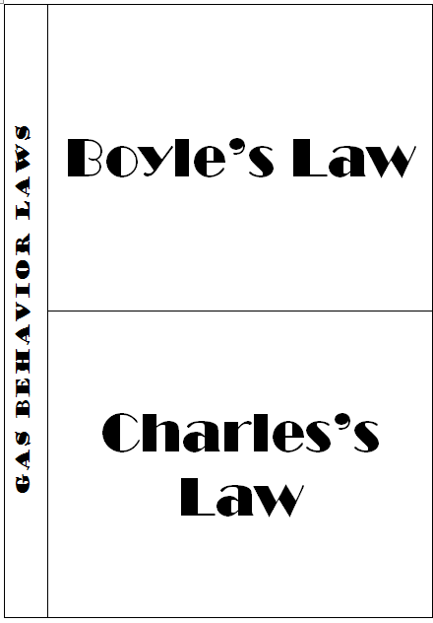

Slide 14
At a constant temperature, the volume of gas will do the opposite of the pressure. So if the volume increases, the pressure will decrease.

Slide 15
At a constant temperature, the volume of gas will do the opposite of the pressure. So if the volume increases, the pressure will decrease.
At a constant pressure, the volume of gas changes in the same way that the temperature changes. So if the temperature increases, the volume of the gas will increase.

Slide 16
 | Temperature | Volume | Pressure
Boyle’s Law
Boyle’s Law
Charles’s Law
Charles’s Law

Slide 17
 | Temperature | Volume | Pressure
Boyle’s Law | constant
Boyle’s Law | constant
Charles’s Law
Charles’s Law

Slide 18
 | Temperature | Volume | Pressure
Boyle’s Law | constant
Boyle’s Law | constant
Charles’s Law
Charles’s Law

Slide 19
 | Temperature | Volume | Pressure
Boyle’s Law | constant
Boyle’s Law | constant
Charles’s Law
Charles’s Law

Slide 20
 | Temperature | Volume | Pressure
Boyle’s Law | constant
Boyle’s Law | constant
Charles’s Law
Charles’s Law

Slide 21
 | Temperature | Volume | Pressure
Boyle’s Law | constant
Boyle’s Law | constant
Charles’s Law
Charles’s Law

Slide 22
 | Temperature | Volume | Pressure
Boyle’s Law | constant
Boyle’s Law | constant
Charles’s Law |  |  | constant
Charles’s Law |  |  | constant

Slide 23
 | Temperature | Volume | Pressure
Boyle’s Law | constant
Boyle’s Law | constant
Charles’s Law |  |  | constant
Charles’s Law |  |  | constant

Slide 24
 | Temperature | Volume | Pressure
Boyle’s Law | constant
Boyle’s Law | constant
Charles’s Law |  |  | constant
Charles’s Law |  |  | constant

Slide 25
 | Temperature | Volume | Pressure
Boyle’s Law | constant
Boyle’s Law | constant
Charles’s Law |  |  | constant
Charles’s Law |  |  | constant

Slide 26
 | Temperature | Volume | Pressure
Boyle’s Law | constant
Boyle’s Law | constant
Charles’s Law |  |  | constant
Charles’s Law |  |  | constant

Slide 27
Boyle’s Law describes a relationship between ____________ and ___________.
Charles’s Law describes a relationship between _____________ and __________.

Slide 28
Boyle’s Law describes a relationship between ____________ and ___________.
Charles’s Law describes a relationship between _____________ and __________.
VOLUME

Slide 29
Boyle’s Law describes a relationship between ____________ and ___________.
Charles’s Law describes a relationship between _____________ and __________.
VOLUME
PRESSURE

Slide 30
Boyle’s Law describes a relationship between ____________ and ___________.
Charles’s Law describes a relationship between _____________ and __________.
VOLUME
PRESSURE
VOLUME

Slide 31
Boyle’s Law describes a relationship between ____________ and ___________.
Charles’s Law describes a relationship between _____________ and __________.
VOLUME
PRESSURE
VOLUME
TEMPERATURE

