Slide 1
Bernoulli’s
Principle

Slide 2
So who was this Bernoulli guy?

Slide 3
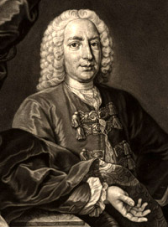
So who was this Bernoulli guy?
Swiss mathematician who came from a family of scientists and mathematicians

Slide 4
Bernoulli’s
Principle

Slide 5
As fluid velocity goes up,

Slide 6
fluid pressure goes DOWN!
As fluid velocity goes UP,

Slide 8
As fluid velocity goes up,

Slide 9
fluid pressure goes DOWN!
As fluid velocity goes UP,

Slide 10
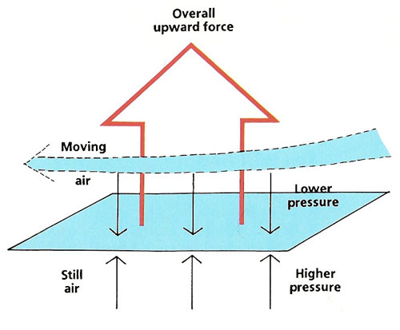

Slide 11
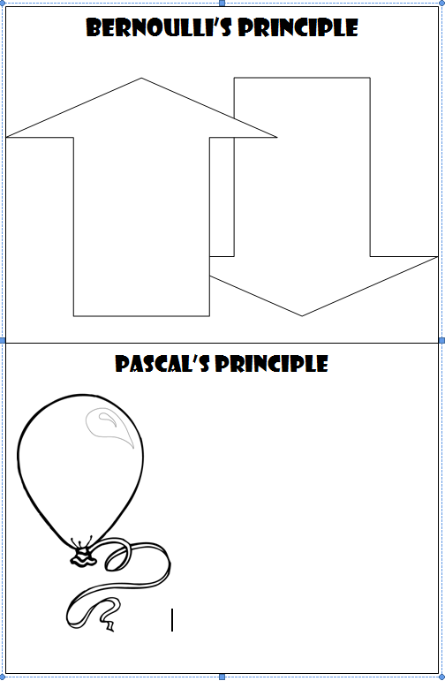
Glue this graphic to page 42 in your Science Notebook!

Slide 12
fluid pressure goes DOWN!
As fluid velocity goes UP,

Slide 13
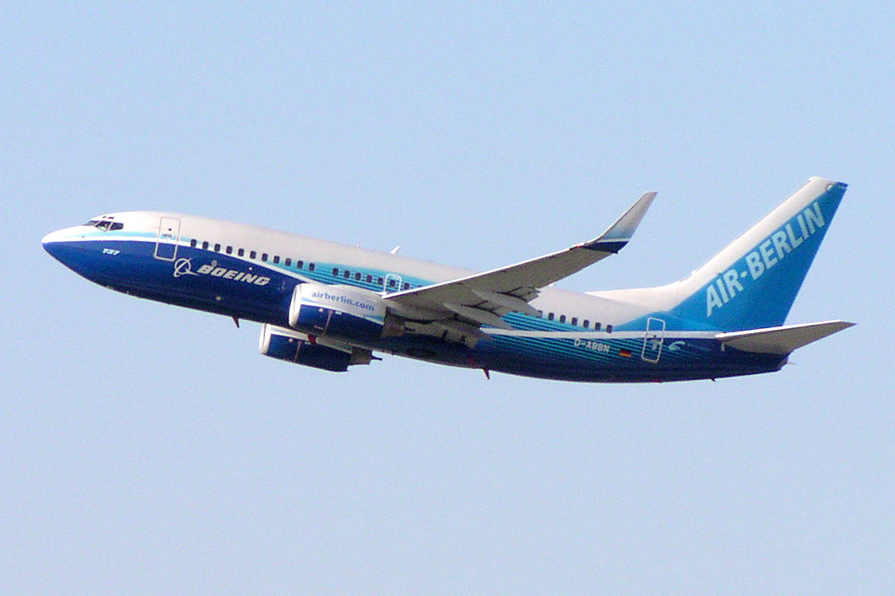
Bernoulli (eventually) makes way for FLIGHT!

Slide 14
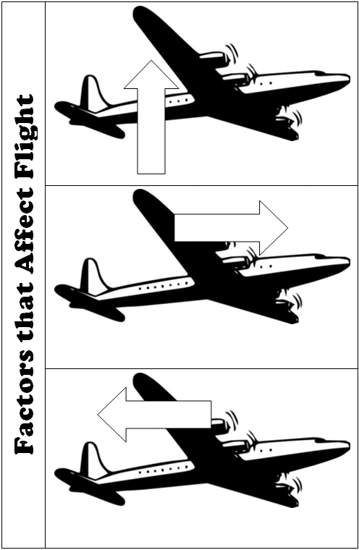
Glue this graphic to page 43 in your SN. Glue down ONLY the spine and cut the flaps so they will open!

Slide 15
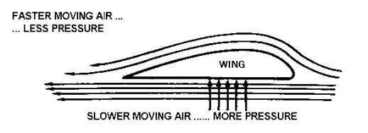

Slide 17
LIFT

Slide 18
LIFT
An upward force on an object in a fluid

Slide 19
LIFT
An upward force on an object in a fluid
**What is the difference between lift and buoyancy?**

Slide 20
LIFT
An upward force on an object in a fluid
!

Slide 21
LIFT
An upward force on an object in a fluid
THRUST

Slide 22
LIFT
An upward force on an object in a fluid
THRUST
The forward force produced by an engine

Slide 23
LIFT
An upward force on an object in a fluid
THRUST
The forward force produced by an engine
Bigger engines=bigger thrust and therefore don’t need bigger wings!

Slide 24
LIFT
An upward force on an object in a fluid
THRUST
The forward force produced by an engine
Bigger engines=bigger thrust and therefore don’t need bigger wings!

Slide 25
LIFT
An upward force on an object in a fluid
THRUST
The forward force produced by an engine
Bigger engines=bigger thrust and therefore don’t need bigger wings!
DRAG

Slide 26
LIFT
An upward force on an object in a fluid
THRUST
The forward force produced by an engine
Bigger engines=bigger thrust and therefore don’t need bigger wings!
DRAG
The force that opposes or restricts motion in a fluid

Slide 27
LIFT
An upward force on an object in a fluid
THRUST
The forward force produced by an engine
Bigger engines=bigger thrust and therefore don’t need bigger wings!
DRAG
The force that opposes or restricts motion in a fluid
Turbulence creates drag and reduces lift!

Slide 29
In a container, fluids exert pressure equally in all directions!

