Slide 1
Changing Overall Density

Slide 2
There are THREE different ways you can change the overall density of an object!

Slide 3
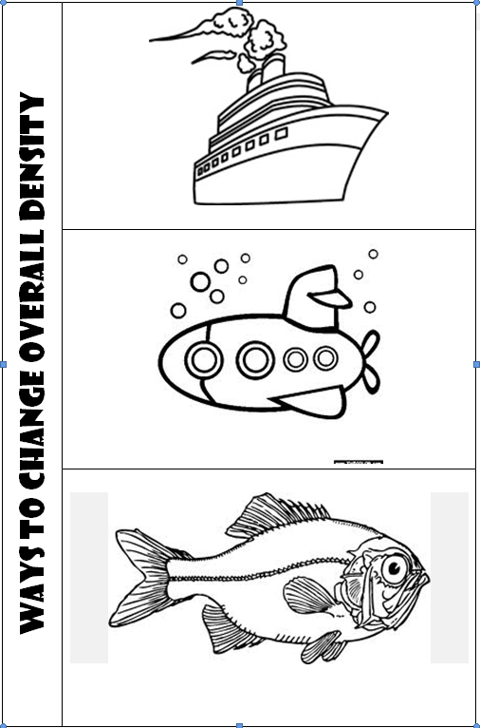
Glue this to page 41 in your SCIENCE NOTEBOOK!

Slide 6
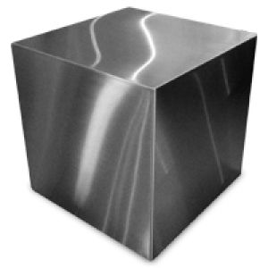
Steel is 8 times MORE dense than water. How does a steel ship manage to float?

Slide 7
Change the Shape
Steel is 8 times MORE dense than water. How does a steel ship manage to float?

Slide 8
Change the Shape
Ships are built with a hollow shape to decrease the density!
Steel is 8 times MORE dense than water. How does a steel ship manage to float?

Slide 9
Change the Shape
Ships are built with a hollow shape to decrease the density!
Steel is 8 times MORE dense than water. How does a steel ship manage to float?

Slide 10
Change the Shape
Ships are built with a hollow shape to decrease the density!
Steel is 8 times MORE dense than water. How does a steel ship manage to float?

Slide 11
Change the Shape
Ships are built with a hollow shape to decrease the density!

Slide 12
Change the Shape
Ships are built with a hollow shape to decrease the density!
Change the Mass

Slide 13
Change the Shape
Ships are built with a hollow shape to decrease the density!
Change the Mass
A submarine uses ballast tanks to increase and decrease the mass. When the mass increases, it sinks.

Slide 14
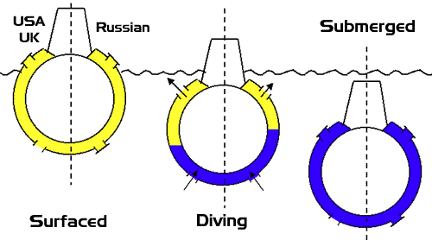
Change the Shape
Ships are built with a hollow shape to decrease the density!
Change the Mass
A submarine uses ballast tanks to increase and decrease the mass. When the mass increases, it sinks.

Slide 15
Change the Shape
Ships are built with a hollow shape to decrease the density!
Change the Mass
A submarine uses ballast tanks to increase and decrease the mass. When the mass increases, it sinks.

Slide 16
Change the Shape
Ships are built with a hollow shape to decrease the density!
Change the Mass
A submarine uses ballast tanks to increase and decrease the mass. When the mass increases, it sinks.

Slide 17
Change the Shape
Ships are built with a hollow shape to decrease the density!
Change the Mass
A submarine uses ballast tanks to increase and decrease the mass. When the mass increases, it sinks.
Change the Volume

Slide 18
Change the Shape
Ships are built with a hollow shape to decrease the density!
Change the Mass
A submarine uses ballast tanks to increase and decrease the mass. When the mass increases, it sinks.
Change the Volume
By increasing and decreasing the volume of their swim bladder, a fish keep from sinking. Sharks do not have a swim bladder so they must swim constantly!

Slide 19
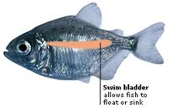
Change the Shape
Ships are built with a hollow shape to decrease the density!
Change the Mass
A submarine uses ballast tanks to increase and decrease the mass. When the mass increases, it sinks.
Change the Volume
By increasing and decreasing the volume of their swim bladder, a fish keep from sinking. Sharks do not have a swim bladder so they must swim constantly!

